Slide 1
VideoTube
A media sharing MVC web application.

Slide 2
Agenda
Background
Made for
Functions
User story
Use case
Requirements
Build needs
Entity relationship diagram
Database table diagrams
Model class listing
SQL script
Draft UI wireframes

Slide 3
Background
As someone learning to be a Cloud App Developer, a media sharing website incorporates many different functions. While being a challenge to implement, this project will give me experience with the following concepts:
Account creation and login
Posting media and comments
Implementing C# code in an MVC project
Practice with HTML, CSS, JavaScript, SQL, and C#
MVC framework
Azure cloud services

Slide 4
Made for
Consumers of video media
Those wanting to gain experience with MVC

Slide 5
Functions
Login page where users can choose to create an account or login
Watch content that others have posted
Post your own videos
Comment on videos

Slide 6
User Story
As a consumer of online content
I need a website that can reliably host media
So I can watch and post videos, as well as post comments

Slide 7
Use Case
User is taken to the sign up/ login page
Sign up option will prompt for email, password, password confirmation, and username
Login option will prompt for username or email, and password
The user will then be taken to their homepage
The user will be able to post, view, and comment on media
The user will also be able to search for specific media

Slide 8
Requirements
Sign up and login website functions
Database that is linked into MVC framework
Ability for a user to post and view media
Comment system

Slide 9
Build needs
Build a database with usernames, passwords, emails, and account information as needed
Design the webpage wireframe and navigation throughout the site
Integrate the database to function with the website
Clean up the interface and put in functions that make the site fun to use

Slide 10
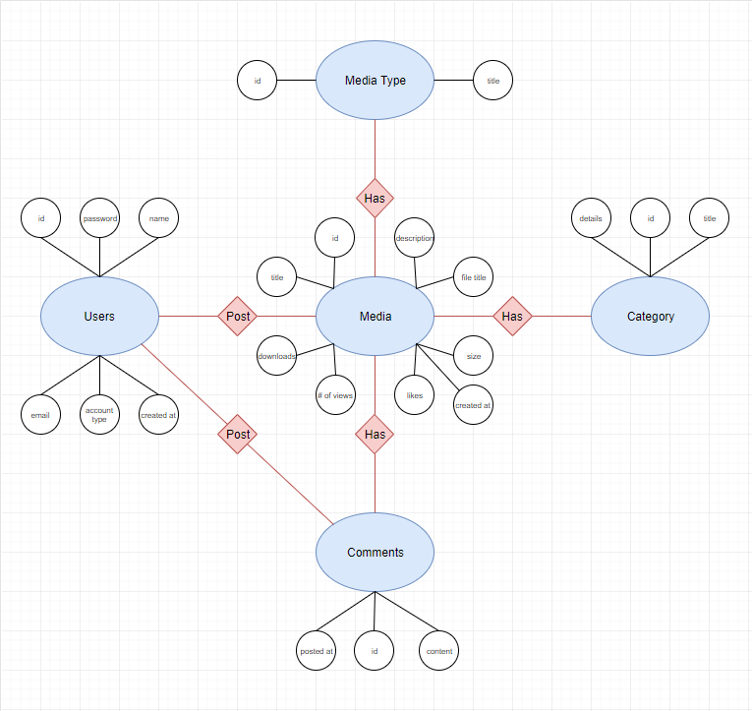
Entity relationship diagram

Slide 11
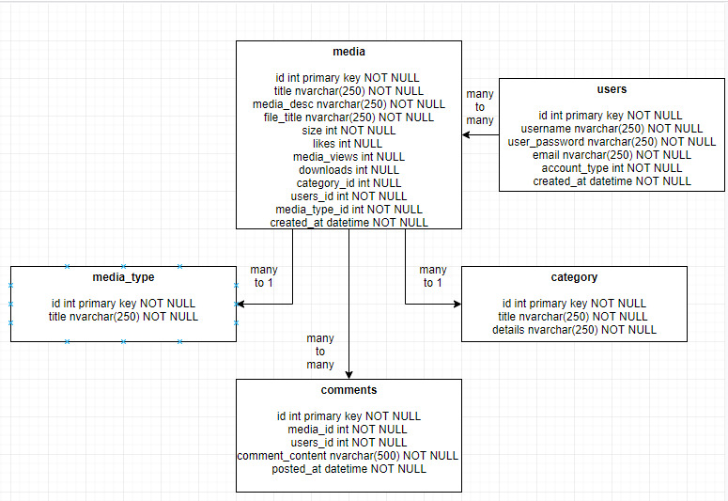
DATABASE TABLE DIAGRAM

Slide 12
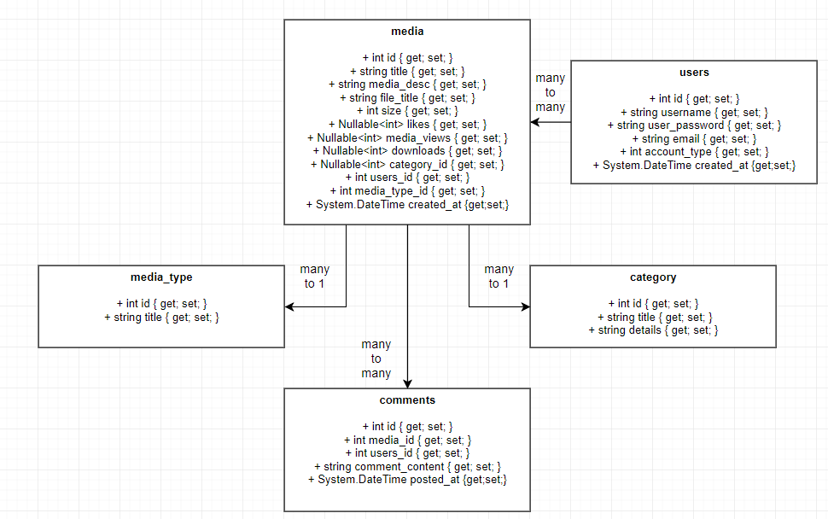
Model class listing (CLASS DIAGRAM)

Slide 13
SQL script
/* Drops and creates the 'MSSA' database. */
-- DROP DATABASE IF EXISTS MSSA;
-- CREATE DATABASE MSSA;
/* Ensures that tables are created for the MSSA database. */
-- USE MSSA;
/* Drops and creates the 'category' table. */
DROP TABLE IF EXISTS category;
CREATE TABLE category
(
id int primary key NOT NULL
,title nvarchar(250) NOT NULL
,details nvarchar(250) NOT NULL
);
/* Drops and creates the 'comments' table. */
DROP TABLE IF EXISTS comments;
CREATE TABLE comments
(
id int primary key NOT NULL
,media_id int NOT NULL
,users_id int NOT NULL
,comment_content nvarchar(500) NOT NULL
,posted_at datetime NOT NULL
);
/* Drops and creates the 'media' table. */
DROP TABLE IF EXISTS media;
CREATE TABLE media
(
id int primary key NOT NULL
,title nvarchar(250) NOT NULL
,media_desc nvarchar(250) NOT NULL
,file_title nvarchar(250) NOT NULL
,size int NOT NULL
,likes int NULL
,media_views int NULL
,downloads int NULL
,category_id int NULL
,users_id int NOT NULL
,media_type_id int NOT NULL
,created_at datetime NOT NULL
);
/* Drops and creates the 'media_type' table. */
DROP TABLE IF EXISTS media_type;
CREATE TABLE media_type
(
id int primary key NOT NULL
,title nvarchar(250) NOT NULL
);
/* Sets the initial values for the different media types. */
INSERT INTO media_type (id, title) VALUES
(1, 'Videos'),
(2, 'Photos'),
(3, 'Music');
/* Drops and creates the 'users' table. */
DROP TABLE IF EXISTS users
CREATE TABLE users
(
id int primary key NOT NULL
,username nvarchar(250) NOT NULL
,user_password nvarchar(250) NOT NULL
,email nvarchar(250) NOT NULL
,account_type int NOT NULL
,created_at datetime NOT NULL
);

Slide 14
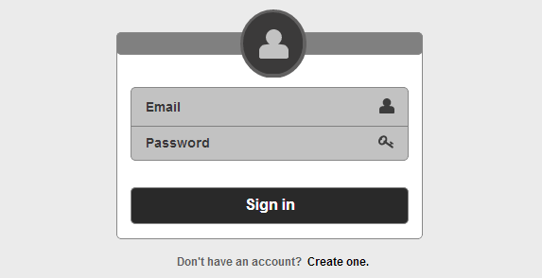
LOGIN wireframe

Slide 15
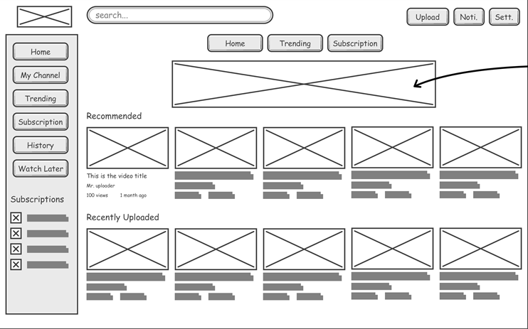
HOMEPAGE wireframe

Slide 16
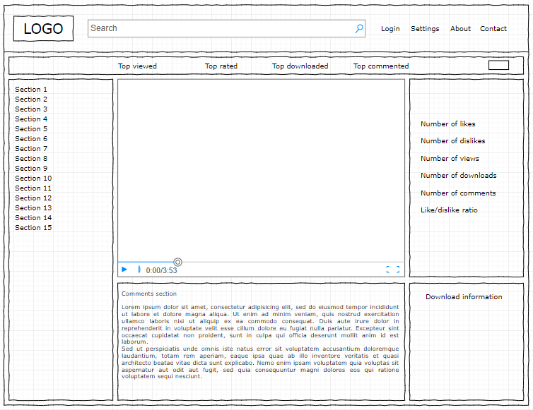
VIDEO wireframe

Slide 17
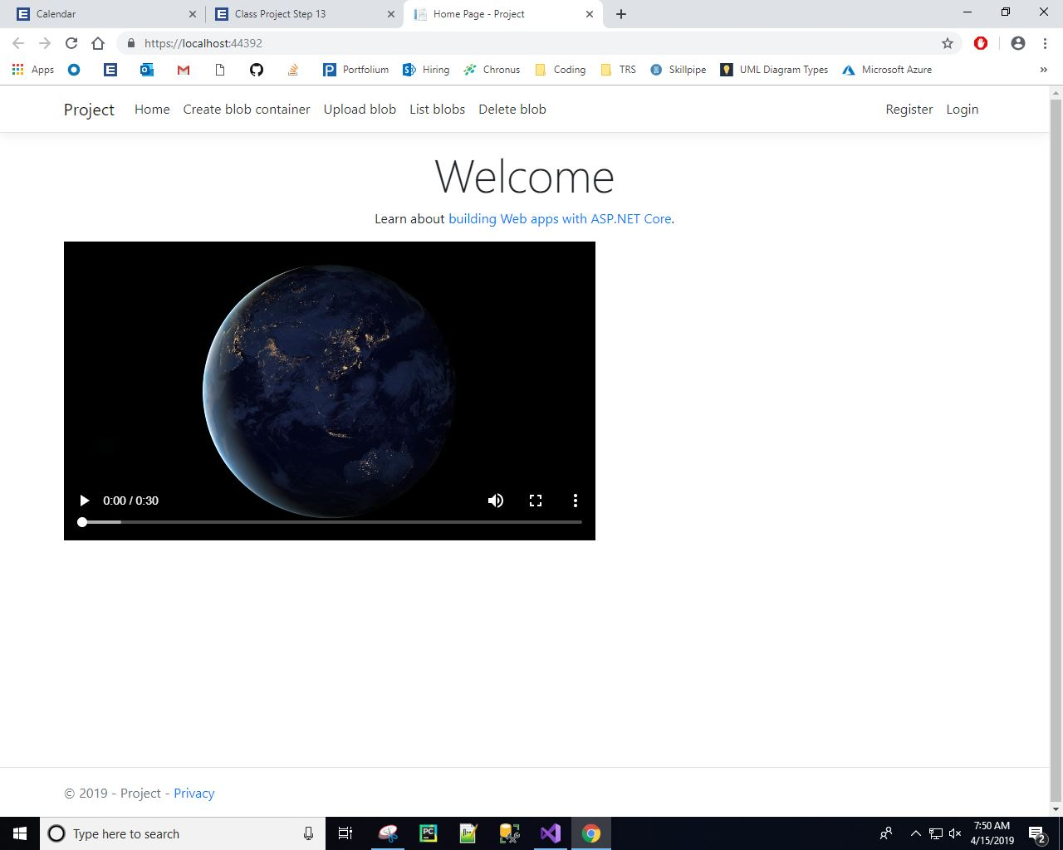

Slide 18
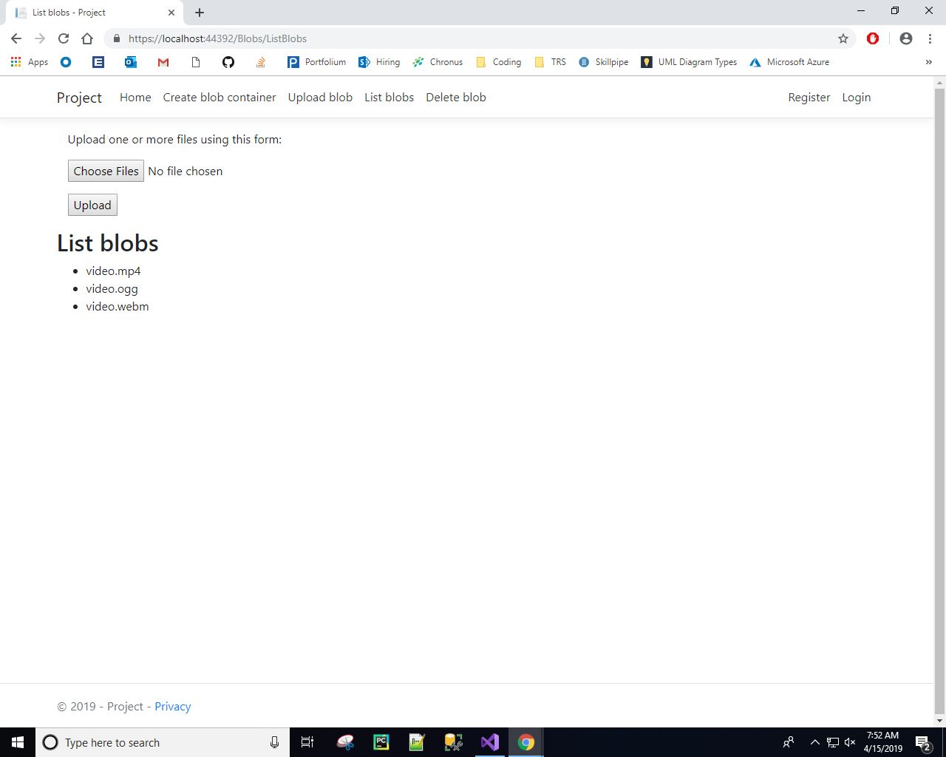

Slide 19
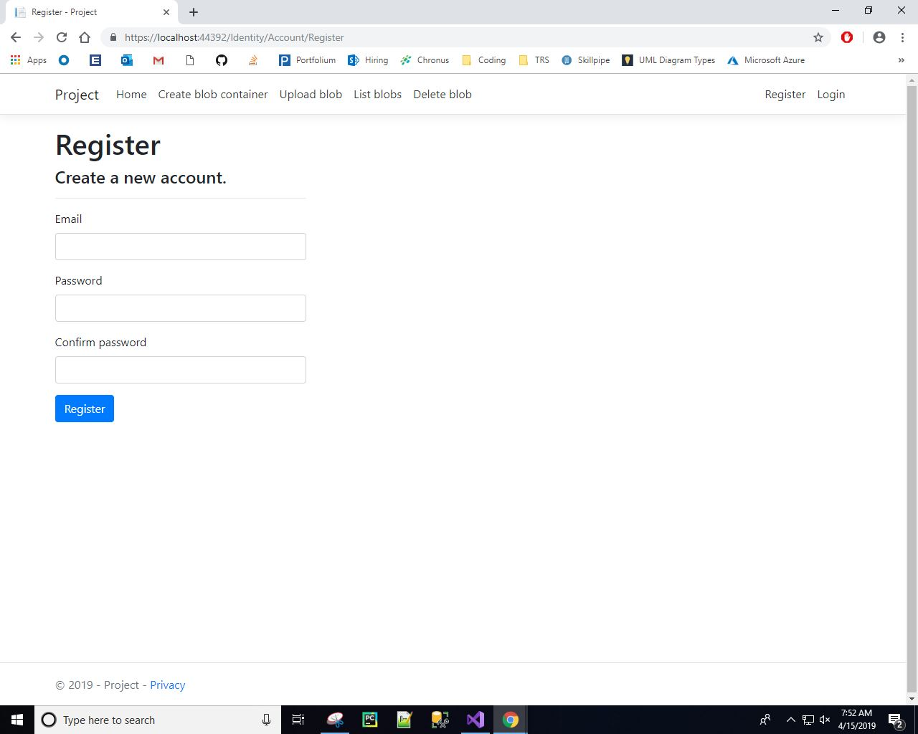

Slide 20
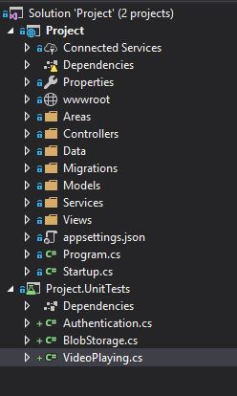

Slide 21
Week 18
Product Release / Project Presentation
Prepare and present your project to include:
each phase of the SDLC and the project artifacts (design documents, requirements trace, test reports...)
code and architecture walk-through
product demonstration
lessons learned:
what did you do right?
what did you do wrong?
where were you lucky?
what would you change?

